Slide 1
Divide and Conquer Approach
Yash N.C.
181210062

Slide 2
Divide and Conquer
Divide and conquer approach consists of breaking a problem into subproblems that are similar to the original problem & recursively solving the subproblems, and finally combining the solutions to the subproblems to solve the original problem, divide and conquer approach solves subproblems recursively, each subproblem must be smaller than the original problem, and there must be a base case for subproblems.

Slide 3
How Divide and Conquer Works ?
Divide and Conquer is approached in three parts :
1)Divide : Dividing the problem into a number of subproblems that are smaller instances of the same problem.
2)Conquer : The subproblems are solved recursively
3)Combine : Combining the solutions to the subproblems into the solution for the original problem.

Slide 4
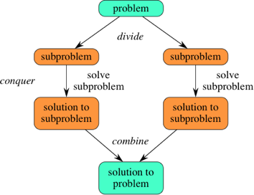
How Divide and Conquer Works ?

Slide 5
Advantages
Divide and conquer method reduces the degree of difficulty since it divides the problem into sub-problems that are easily solvable, and usually runs faster than other algorithms would.
It also uses memory caches effectively. The reason for this is the fact that when the sub problems become simple enough, they can be solved within a cache, without having to access the slower main memory, which saves time and makes the algorithm more efficient.
Disadvantages
Issues with this sort of algorithm is the fact that the recursion is slow, which in some cases outweighs any advantages.
Recursive nature of the solution may end up duplicating sub-problems, dynamic/memoized solutions may be better in some of these cases, like Fibonacci.

Slide 6
Real Life Applications of Divide and Conquer
Binary Search
Merge Sort
Quick Sort
Closest Pair of Points
Strassen’s Multiplication
Karatsuba Algorithm
Cooley-Tukey Algorithm

Slide 7
Sorting of given elements (Merge Sort)
Input of N elements is given by the user and the elements are sorted in ascending order

Slide 8
Merge Sort
Merge sort is a divide-and-conquer algorithm based on the idea of breaking down a list into several sub-lists until each sublist consists of a single element and merging those sublists in a manner that results into a sorted list.
Merge Sort is a recursive algorithm and time complexity can be expressed as following recurrence relation :
T(n) = O(n log n)

Slide 9
Idea of solving problems using Merge Sort
Divide the Unsorted list of N elements into sublists containing 1 element
Merging adjacent pairs of two sublists containing 1 element to form list of two elements
Repeat the process till a single sorted list of obtained.

Slide 10
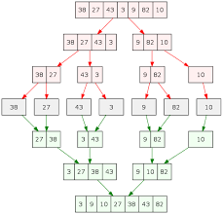
Idea of solving problems using Merge Sort
Example :

Slide 11
Why use Merge sort ?
Merge sort is often preferred for sorting a linked list. The slow random-access performance of a linked list makes some other algorithms (such as quicksort) perform poorly.
Merge sort is stable algorithm which means it sorts the identical elements in their same order as they appear in the input.
Merge Sort is also prefered because the worst case complexity of quick sort is O(n2), & bubble sort is O(n^2) as there is need of lot of comparisons in the worst condition whereas In merge sort, worst case and average case has same complexities O(n log n).

